Slide 1
STOCK MARKET PREDICTION BY USING MACHINE LEARNING AND DEEP LEARNING.

Slide 2
AIM OF THE PROJECT
We proposed to predict the Stock Market trend using Machine Learning Techniques and Deep Learning.
Machine Learning and Deep Learning approach that will be trained from the available stocks data and gain intelligence and then uses the acquired knowledge for an accurate prediction.
To develop an intelligent system that accurately predicts stock market trends using Machine Learning and Deep Learning techniques by analyzing historical stock data, identifying patterns, and providing data-driven insights to support investment decision-making.

Slide 3
ABSTRACT
The stock market has always been a promising avenue for lucrative investing, but most of the profit making depends on the analysis of the current and past market scenario followed by subsequent predictive actions. The currently overblown market economy has given rise to numerous variables which need to be considered before making a beneficial transaction in the stock market. Manually analyzing all these variables and affecting factors is too cumbersome and error prone. In the finance world stock trading is one of the most important activities. Stock market prediction is an act of trying to determine the future value of a stock other financial instrument traded on a financial exchange. The technical and fundamental or the time series analysis is used by the most of the stockbrokers while making the stock predictions. The programming language is used to predict the stock market using machine learning and deep learning in Python. Here, we use the Machine Learning algorithm like linear regression and Decision tree as well as the Deep Learning algorithm like models are used. Experimental results shown the better performance of the system.

Slide 4
INTRODUCTION
Stock Market prediction and analysis is the act of trying to determine the future value of a company stock or other financial instrument traded on an exchange. Stock market is the important part of economy of the country and plays a vital role in the growth of the industry and commerce of the country that eventually affects the economy of the country. Both investors and industry are involved in stock market and wants to know whether some stock will rise or fall over certain period of time. The stock market is the primary source for any company to raise funds for business expansions. Stock analysis refers to the method that an investor or trader uses to evaluate and investigate a particular trading instrument, investment sector, or the stock market as a whole. Stock analysis is also called equity analysis or market analysis. Investors or traders make buying or selling decisions based on stock analysis information. Stock analysis helps traders to gain an insight into the economy, stock market, or securities. It involves studying the past and present market data and creating a methodology to choose appropriate stocks for trading. Stock analysis also includes the identification of ways of entry into and exit from the investments.

Slide 5
EXISTING SYSTEM
Stock market analysis and prediction will reveal the market patterns and predict the time to purchase stock. The successful prediction of a stock's future price could yield significant profit. This is done using large historic market data to represent varying conditions and confirming that the time series patterns have statistically significant predictive power for high probability of profitable trades and high profitable returns for the competitive business investment. Machine learning is a method of data analysis that automates analytical model building. The Existing System invest based on some kind of prediction. Employing traditional methods like technical and fundamental analysis may not ensure the reliability of the prediction.
Although one can never be sure of the rise and fall of the Market, predicting it to a great extent is very much possible using the modern techniques of Machine Learning (ML), Data Mining.
Existing paper survey various approaches including Support Vector Machine (SVM), Random Forests (RF) in stock Prediction and have a high possibility of advancement in the future.

Slide 6
DISADVANTAGES
Feature Extraction is very Complex.
Given Less Accuracy.
Performance level is very Low.
High Sensitivity to Market Volatility.
Need for High-Quality Data.

Slide 7
PROPOSED SYSTEM
In the last few decades forecasting of stock returns has become an important field of research. We will develop a financial data predictor program in which there will be a dataset storing all historical stock prices and data will be treated as training sets for the program.
The main purpose of the prediction is to reduce uncertainty associated to investment decision making. This study employs different stock market data to be tested by different classifiers, in order to find the best machine learning algorithm for stock market forecasting. we propose a Machine Learning (ML) and Deep Learning approach that will be trained from the available stocks data and gain intelligence and then uses the acquired knowledge for an accurate prediction. Our proposed system uses a Linear Regression, Decision tree algorithm and LSTM methods to predict stock prices for the large and small capitalizations and in the three different markets, employing prices with both daily and up-to-the-minute frequencies. Both algorithm shown the future prediction data of the system.

Slide 8
ADVANTAGES
High Performance and accuracy.
Easily Extract the Features.
High Level Prediction of Risk Analysis.
Automated Learning from Large Datasets.
Adaptability and Continuous Improvement.

Slide 9
SYSTEM ARCHITECTURE
Historical Stock Data
Data Pre-Processing
Data Visualization
Linear Regression, Decision Tree
Machine Learning Algorithm
Learning Algorithm
Deep Learning Algorithm
Final Prediction for Future

Slide 10
SYSTEM MODULES
Module 1: Data Collection
Module 2: Pre-processing
Module 3: Data Visualization
Module 4: Model Implementation
Module 5: Prediction

Slide 11
MODULE DESCRIPTIONS
Module 1: Data Collection:
A dataset (or data set) is a collection of data, usually presented in tabular form. Each column represents a particular variable. Each row corresponds to a given member of the dataset in question. It lists values for each of the variables, such as height and weight of an object. Each value is known as a datum. We have chosen to use a publicly-available dataset which contains a relatively small number of inputs and cases. The data is arranged in such a way that will allow those trained in medical disciplines to easily draw parallels between familiar statistical and novel ML and DL techniques.
Additionally, the compact dataset enables short computational times on almost all modern computers. Here, we use the dataset is a CSV file format to process to fetch the data in the Kaggle website.

Slide 12
MODULE DESCRIPTIONS
Module 2: Data Pre Processing
The sklearn.preprocessing package provides several common utility functions and transformer classes to change raw feature vectors into a representation that is more suitable for the downstream estimators.
In general, learning algorithms benefit from standardization of the data set. If some outliers are present in the set, robust scalers or transformers are more appropriate. The behaviours of the different scalers, transformers, and normalizers on a dataset containing marginal outliers is highlighted in Compare the effect of different scalers on data with outliers.
To Preprocess the data, we used the steps are data describe, data information, data shape and then to check the data to align the proper format of the system.

Slide 13
MODULE DESCRIPTIONS
Module 3: Data Visualization:
Data visualization is the representation of data through use of common graphics, such as charts, plots, info graphics, and even animations. These visual displays of information communicate complex data relationships and data-driven insights in a way that is easy to understand. Here, we use the EDA concept to visualize the data of the system. Exploratory data analysis (EDA) is used by data scientists to analyze and investigate data sets and summarize their main characteristics, often employing data visualization methods.
Exploratory Data Analysis (EDA) is one of the techniques used for extracting vital features and trends used by machine learning and deep learning models in Data Science. EDA is applied to investigate the data and summarize the key insights. It will give you the basic understanding of your data, it's distribution, null values and much more. You can either explore data using graphs or through some python functions. Python has many in-built functions for data cleaning and data analysis.

Slide 14
MODULE DESCRIPTIONS
Module 4: Model Implementation:
Here we Implement Linear regression and Decision tree algorithm in machine learning as well as the Algorithm in Deep learning
Linear Regression:
Linear regression analysis is used to predict the value of a variable based on the value of another variable. The variable you want to predict is called the dependent variable. The variable you are using to predict the other variable's value is called the independent variable. Linear regression is commonly used for predictive analysis and modeling. In statistics, a regression equation (or function) is linear when it is linear in the parameters. While the equation must be linear in the parameters, you can transform the predictor variables in ways that produce curvature.

Slide 15
Decision Tree:
Decision Tree is a Supervised learning technique that can be used for both classification and Regression problems, but mostly it is preferred for solving Classification problems. It is a tree-structured classifier, where internal nodes represent the features of a dataset, branches represent the decision rules and each leaf node represents the outcome.
In a Decision tree, there are two nodes, which are the Decision Node and Leaf Node. Decision nodes are used to make any decision and have multiple branches, whereas Leaf nodes are the output of those decisions and do not contain any further branches.
The decisions or the test are performed on the basis of features of the given dataset.

Slide 16
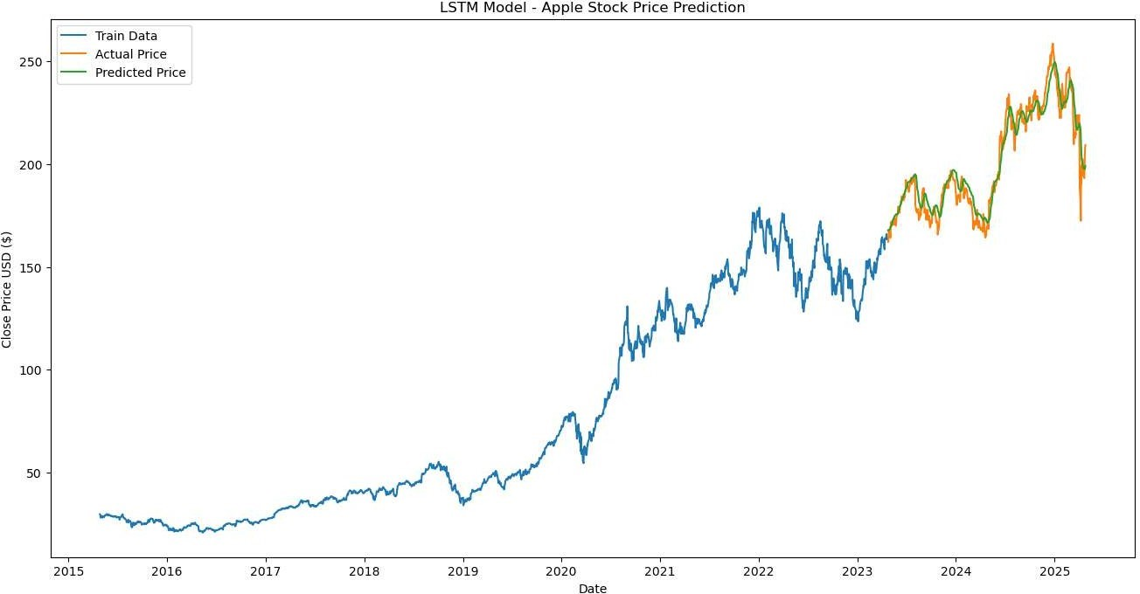
MODULE DESCRIPTIONS
Module 5: Prediction
Finally, we predict the result based on each and every algorithm accuracy score as well as the future prediction graph both machine learning and deep learning algorithm are show in the final system.

Slide 17
SOFTWARE REQUIREMENTS
Operating System : Windows 7,8,10 (64 bit)
Software : Python
Libraries : Numpy, Pandas, Matplotlib, Scikit-Learn
Data Source : yfinance

Slide 18
HARDWARE REQUIREMENTS
Hard Disk : 500GB and above
RAM : 4GB and above
Processor : I5 and above
Environment : Google Colab and Anaconda Jupyter

Slide 19
CONCLUSION
In this research, we sought to understand the set of information present in the financial market and identify the variables that drive stock prices, taking into account the activities performed and economy sectors, the various industry, macroeconomic and market indicators. The methodology presented may be adapted to other enterprises and their stocks. Theoretically, the discussion on the predictions of stock prices is still controversial and unproductive. However, from the empirical standpoint, this research proved to be very productive, with some methods for financial market prediction being developed and demonstrated. Stock market forecasting is a trending topic in the market nowadays. Therefore, our study focuses on both machine learning algorithms like linear regression, Decision Tree algorithm as well as the deep learning algorithm are LSTM. Further, results concluded that both the future prediction of machine learning graph as well as the deep learning graph. By Using these Algorithm, we get an accuracy score . Comparing these Accuracy score from Linear regression and Decision Tree and LSTM. We pick the better accuracy algorithm by comparing the three algorithm to predict the Stock Market Prediction.

Slide 20
REFERENCES
[1] Wei Huang, Yoshiteru Nakamori, Shou-Yang Wang, “Forecasting stock market movement direction with support vector machine”, Computers & Operations Research, Volume 32, Issue 10, October 2020, Pages 2513–2522.
[2] Debashish Das “Data mining and neural network techniques in stock market prediction”: a methodological review, international journal of artificial intelligence & applications, vol.4, no.1, January 2023
[3] Khaidem, L., Saha, S., & Dey, S. R. (2021). Predicting the direction of stock market prices using random forest
[4] Patel, J., Shah, S., Thakkar, P., & Kotecha, K. (2021). Predicting stock and stock price index movement using Trend Deterministic Data Preparation and machine learning techniques. Expert Systems with Applications, 42(1), 259–268. https://doi.org/10.1016/j.eswa.2014.07.040
[5] Olivier C., Blaise Pascal University: “Neural network modeling for stock movement prediction, state of art”. 2020

